Slide 1


Advanced Object-Oriented Programming (C#)
SOLID Principles

Slide 2

Story Framework Recap
You’re the city’s foundational architects. Before building skyscrapers, roads, or power grids, you need to lay strong, well-planned foundations. To do this in software, we use SOLID principles — essential guidelines to keep code clean, flexible, and scalable.

Slide 3
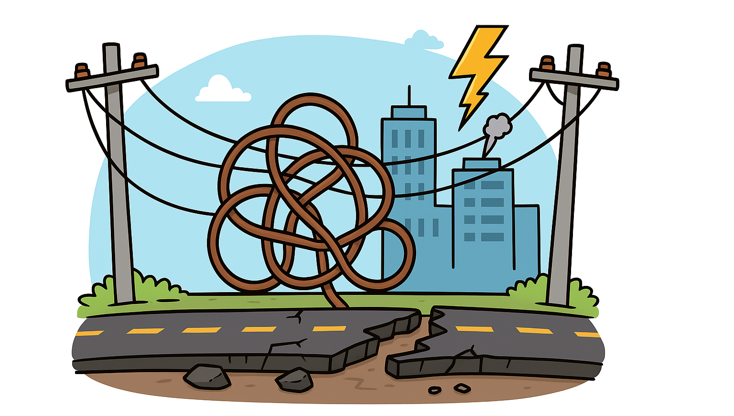
Why Does Good Design Matter? – City Analogy
Messy code can cause:
Rigidity: Hard to change one thing without breaking others
Fragility: Small changes cause bugs in unrelated parts
Duplication: Copy-pasted code everywhere
Difficulty Extending: Adding features takes too long and introduces errors
City Analogy:
Imagine a city with tangled power lines, roads breaking easily, and services crashing.
This is what messy, tightly coupled code feels like.
To prevent this, architects rely on principles — just like programmers rely on SOLID.

Slide 4
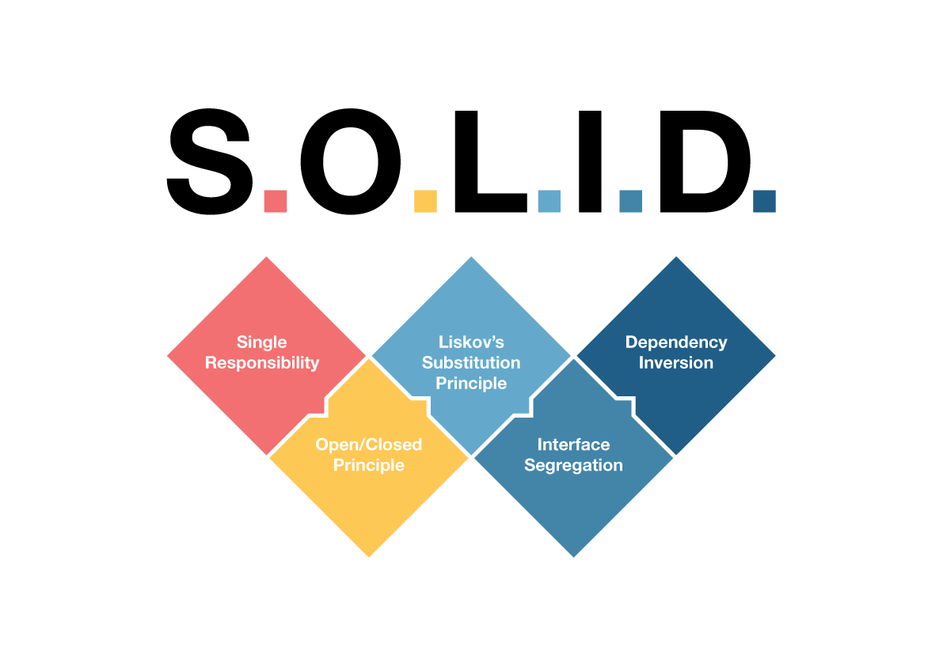
What Are SOLID Principles?
SOLID is an acronym for five design principles that make code easier to maintain and extend:
Single Responsibility
Open/Closed
Liskov’s Substitution
Interface Segregation
Dependency Inversion
They are like the blueprints for a strong city foundation.

Slide 5
Single Responsibility Principle (SRP)
SRP states:
“A class should have one, and only one, reason to change.”
This means each class should have a single responsibility or job, and that responsibility should be encapsulated fully within the class.
When a class handles multiple responsibilities, it becomes fragile and hard to maintain because changes related to one responsibility can break others.
Class violating SRP public class CityService
{
public void FixRoads()
{
Console.WriteLine("Fixing roads...");
}
public void RespondToEmergency()
{
Console.WriteLine("Responding to emergency...");
}
public void ProcessCitizenRequest()
{
Console.WriteLine("Processing citizen request...");
}
}
Why SRP Matters?
Improves maintainability: Changes to one responsibility don’t affect unrelated parts of the code.
Simplifies testing: Smaller classes with one function are easier to test thoroughly.
Enables better reusability: A class that does one thing well can be reused without unintended side effects.
Supports parallel development: Multiple teams can work on different classes independently without conflicts.

Slide 6
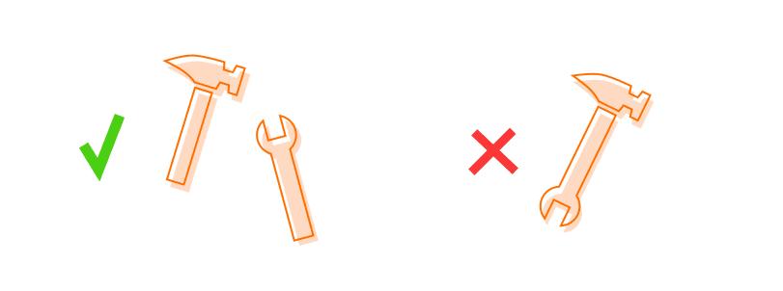
SRP Continued…
public class RoadMaintenanceService
{
public void FixRoads()
{
Console.WriteLine("Fixing roads...");
}
}
public class EmergencyResponseService
{
public void RespondToEmergency()
{
Console.WriteLine("Responding to emergency...");
}
}
public class CitizenRequestService
{
public void ProcessCitizenRequest()
{
Console.WriteLine("Processing citizen request...");
}
}
public class CityManager
{
private readonly RoadMaintenanceService _roadService;
private readonly EmergencyResponseService _emergencyService;
private readonly CitizenRequestService _citizenService;
public CityManager(RoadMaintenanceService roadService,
EmergencyResponseService emergencyService,
CitizenRequestService citizenService)
{
_roadService = roadService;
_emergencyService = emergencyService;
_citizenService = citizenService;
}
public void HandleCityOperations()
{
_roadService.FixRoads();
_emergencyService.RespondToEmergency();
_citizenService.ProcessCitizenRequest();
}
}

Slide 7
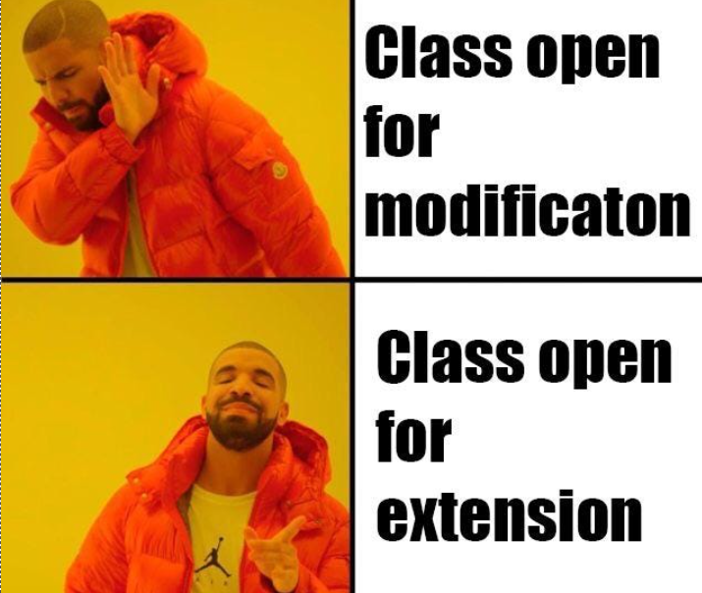
Open/Closed Principle (OCP)
OCP states:
“Software entities (classes, modules, functions, etc.) should be open for extension, but closed for modification.”
Meaning: Add new functionality by adding code, not changing existing tested code.
Class violating OCP public class Building
{
public string Type { get; set; }
public void Construct()
{
if (Type == "House")
{
Console.WriteLine("Constructing a House.");
}
else if (Type == "Hospital")
{
Console.WriteLine("Constructing a Hospital.");
}
else
{
Console.WriteLine("Constructing a generic building.");
}
}
}
Why OCP Matters?
Protects existing, tested code from bugs.
Makes adding features faster and safer.

Slide 8
OCP Continued…
public interface IBuilding
{
void Construct();
}
public class House : IBuilding
{
public void Construct() => Console.WriteLine("Constructing a House.");
}
public class Hospital : IBuilding
{
public void Construct() => Console.WriteLine("Constructing a Hospital.");
}
public class CityManager
{
public void Build(IBuilding building)
{
building.Construct();
}
}
CityManager doesn’t change to support new building types — it’s closed for modification.
public class Library : IBuilding
{
public void Construct() => Console.WriteLine("Constructing a Library.");
}
CityManager cityManager = new CityManager();
IBuilding library = new Library();
cityManager.Build(library); // Output: Constructing a Library.
Adding new buildings means adding new code — no changes to existing classes.

Slide 9
Liskov’s Substitution Principle (LSP)
LSP states:
“Subtypes must be substitutable for their base types without breaking the correctness of the program.”
LSP is about designing your class hierarchies so that objects of derived classes can replace objects of the base class without affecting the program’s correctness. It means any function using a base class reference should work perfectly with any subclass instance—no surprises, no errors.
Class violating LSP public abstract class WaterPipe
{
public abstract void CarryWater();
}
public class StandardPipe : WaterPipe
{
public override void CarryWater()
{
Console.WriteLine("Carrying water through standard pipe.");
}
}
public class BrokenPipe : WaterPipe
{
public override void CarryWater()
{
throw new Exception("Pipe is broken and leaks water!");
}
}
Why LSP Matters?
This ensures polymorphism works safely and reliably. When violated, subclasses may break expectations, causing runtime failures or unpredictable behavior.

Slide 10
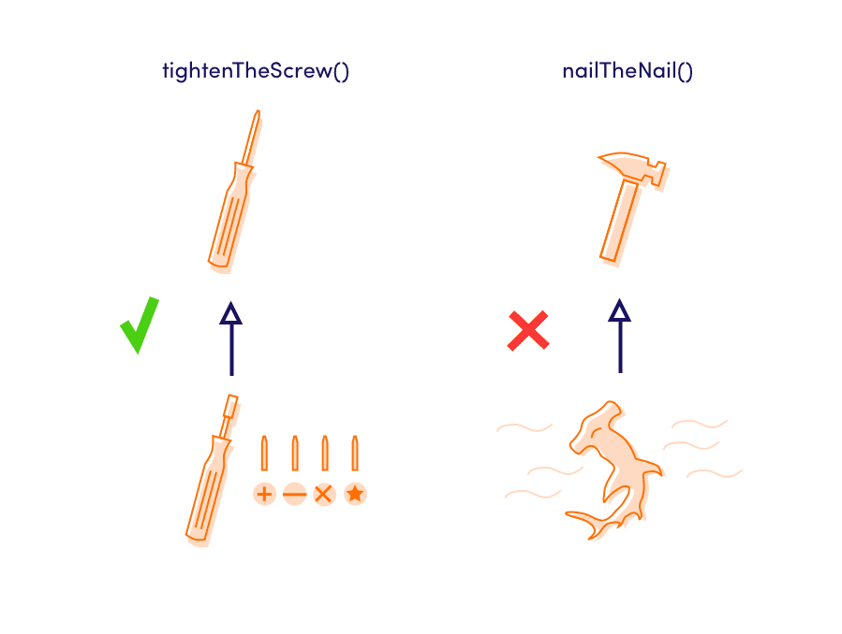
LSP Continued…
public abstract class WaterPipe
{
public abstract void CarryWater();
}
public class StandardPipe : WaterPipe
{
public override void CarryWater()
{
Console.WriteLine("Carrying water through standard pipe.");
}
}
public class HighPressurePipe : WaterPipe
{
public override void CarryWater()
{
Console.WriteLine("Carrying water through high pressure pipe.");
}
}
public class BrokenPipe
{
public void Repair()
{
Console.WriteLine("Repairing broken pipe.");
}
}
public class WaterDistributionSystem
{
public void DistributeWater(WaterPipe pipe)
{
pipe.CarryWater();
}
} WaterDistributionSystem system = new WaterDistributionSystem();
WaterPipe standardPipe = new StandardPipe();
WaterPipe highPressurePipe = new HighPressurePipe();
system.DistributeWater(standardPipe);
// Output: Carrying water through standard pipe.
system.DistributeWater(highPressurePipe);
// Output: Carrying water through high pressure pipe.

